Slide 1
Other site employee how to order WJ building badge

Slide 2
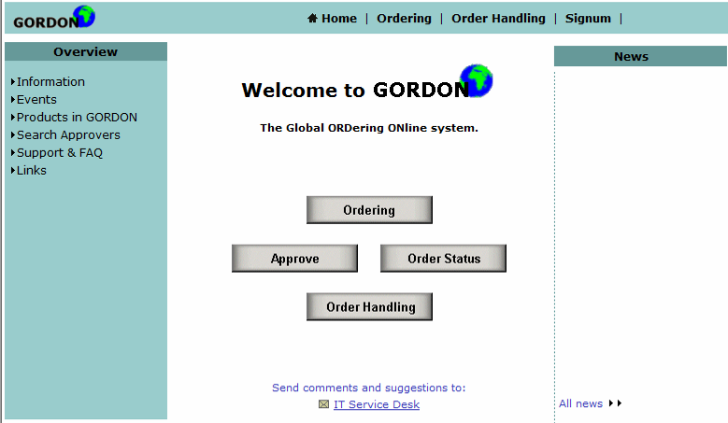
Step 1 - Choose “Ordering”

Slide 3
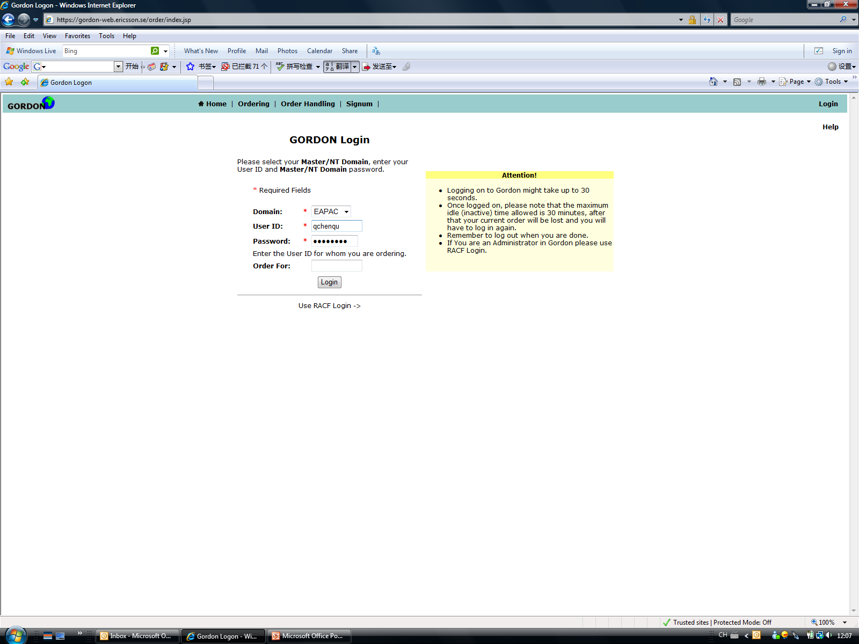

Step 2 - Gordon Login
Domain: EAPAC
Input your ID and password
Order for:Please sign employee’s user id who do you want to order

Slide 4
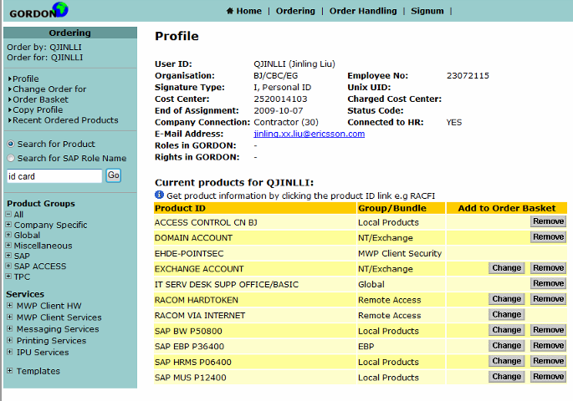
Step 3 - Search for “ID card”

Slide 5
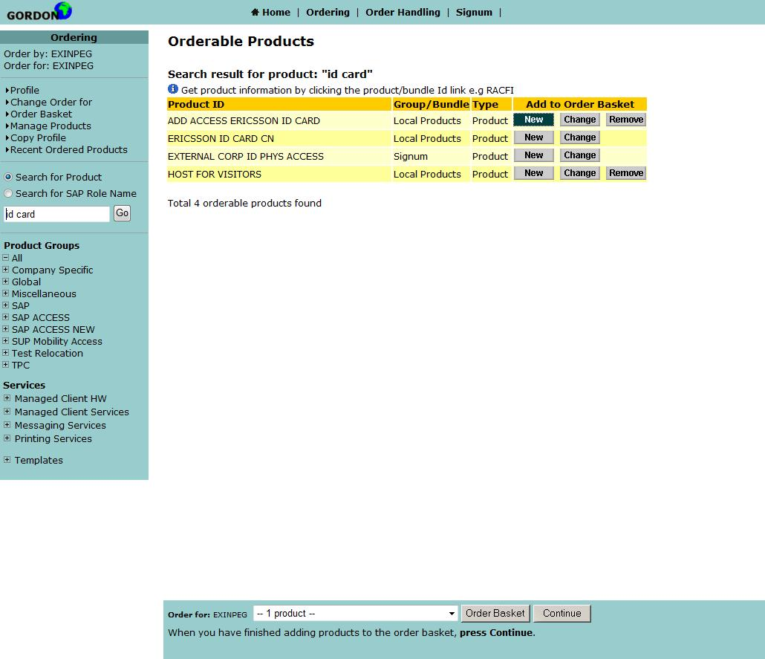
Step 4
Choose “ADD ACCESS ERICSSON ID CARD”
Choose “New”
Click Continue

Slide 6
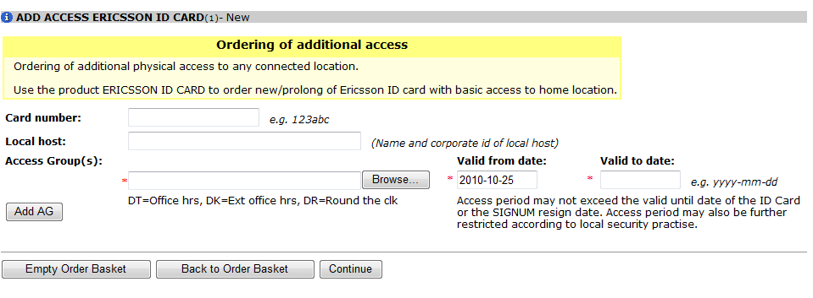
Step 5
Choose “Browse”

Slide 7
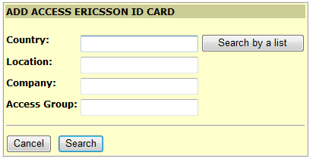
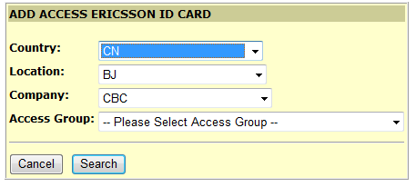
Step 6
Click :Search by list
Choose:Country:CN-Location:BJ-Company:CBC

Slide 8
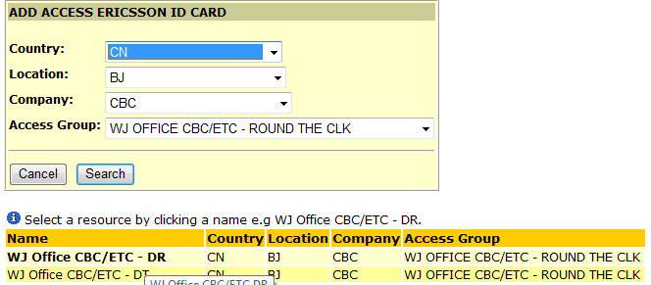
Step 7
Access group please choose :which access do you want to order
Normal access right(7*24hours)please choose:WJ office CBC/ETC round the clock

Slide 9
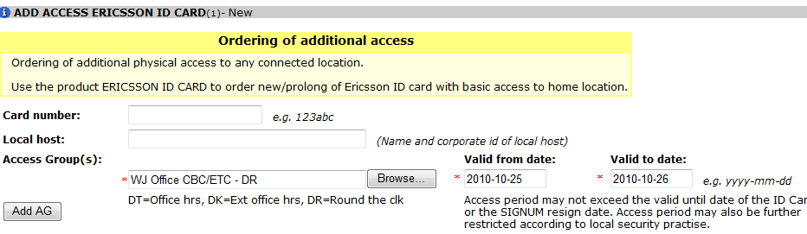
Step 8
Valid to date :need to be written your self
Click:Continue

Slide 10
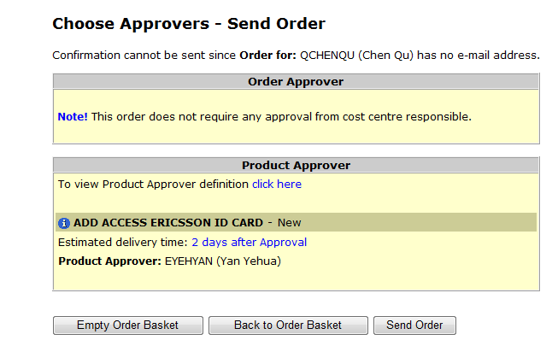
Step 9
Choose :Approver
Click:Send order
Order completed

Slide 11
If you need to take photo,please pay attention to the following.
Time:Every Monday，Wednesday，Friday 14:00-16:30
Venue:WJ 1F ID office

Slide 12


